Slide 1
Integrated label-free PANORAMA and fluorescence imaging for multi-modal exosome analysis
April-7-2021
Pres. By Nareg Ohannesian

Slide 2
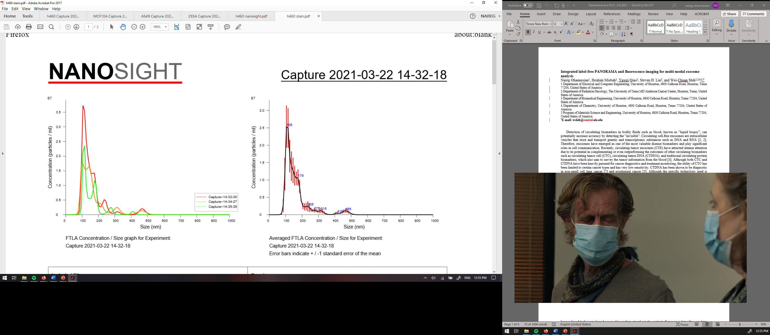
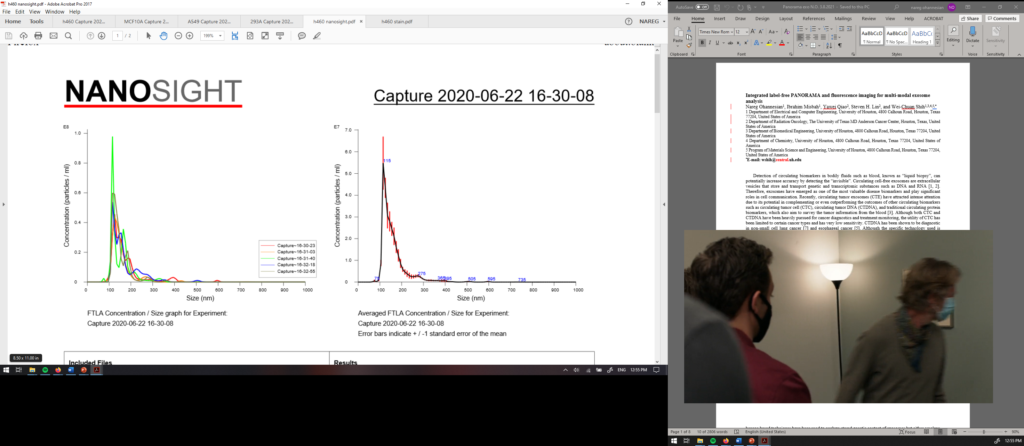
Experimental Details
H460 derived exosomes
H460 derived exosomes stained with PKH67
Exosome used: H460; H460 labelled with PKH67
Antibody for capture: CD63
Experiment duration: 120 min
Concentrations used: 2x10³, 2x10⁵ ex/ µl.
Thiol-PEG Biotinylated/methylated: (1:3) 1 mM
Neutravidin: 3.3 µM
Antibody: 50 µg/ml
PKH67:
Excitation wavelength: 460-490 nm
Emission wavelength: 500-530 nm
Fluorescence filters:
Excitation wavelength: 445-490 nm
Emission wavelength: 500-550 nm
Fluorescence acquisition time: 0.1 sec
Notes:
Add acquisition time; increase brightness of overlay.

Slide 3
Overview
Validation of PANORAMA with fluorescence using fluorescence 100 nm particles
Monitoring the surface functionalization
Monitoring number of exosomes settled with time
Validation of the surface functionalization
Monitoring the number of captured exosomes on anti-CD63 functionalized surface
Determining the non-specific binding in the system

Slide 4
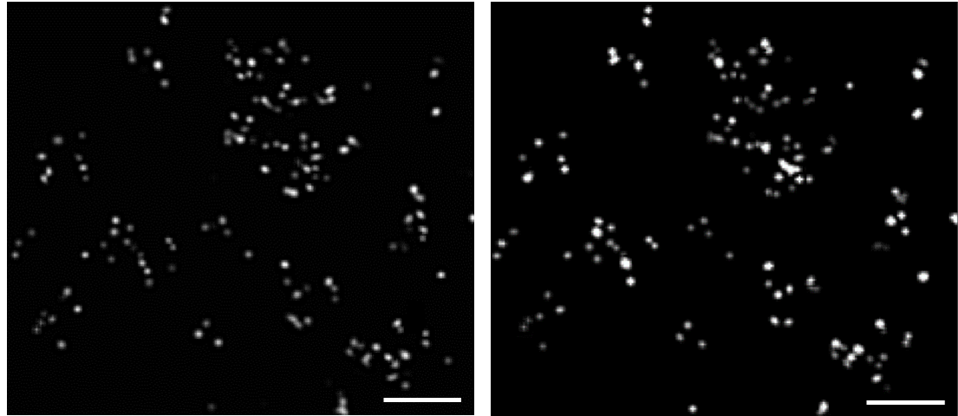
Part 1: Detection of Carboxylate modified 100 nm polystyrene beads via PANORAMA and fluorescence
PANORAMA
1.165±0.045
Fluorescence
3050±1025
Scale Bar: 8 µm

Slide 5
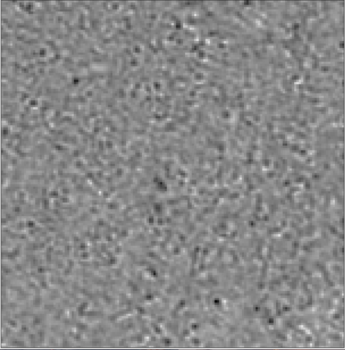
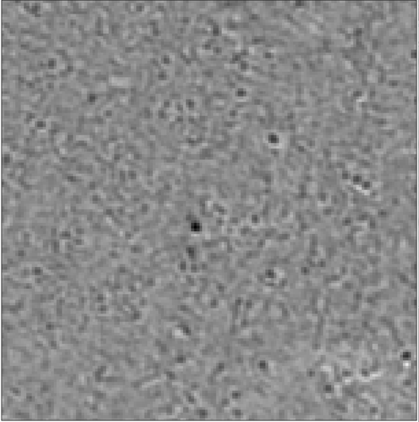
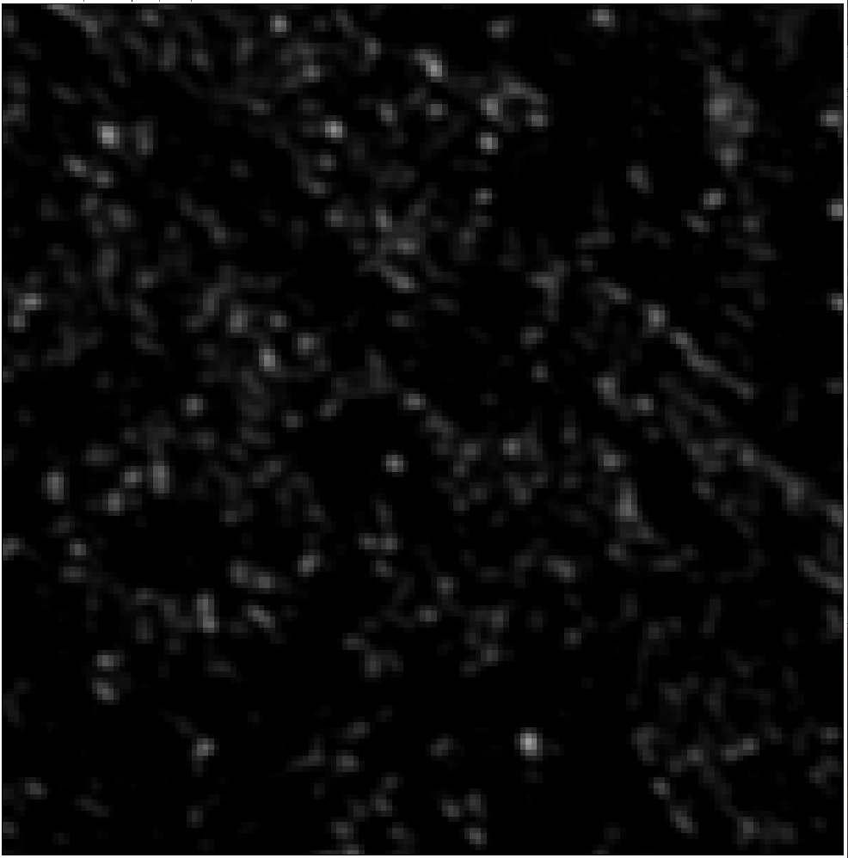
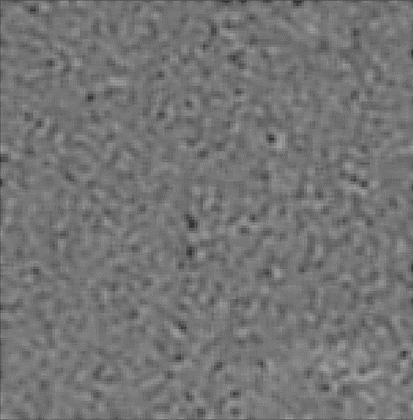
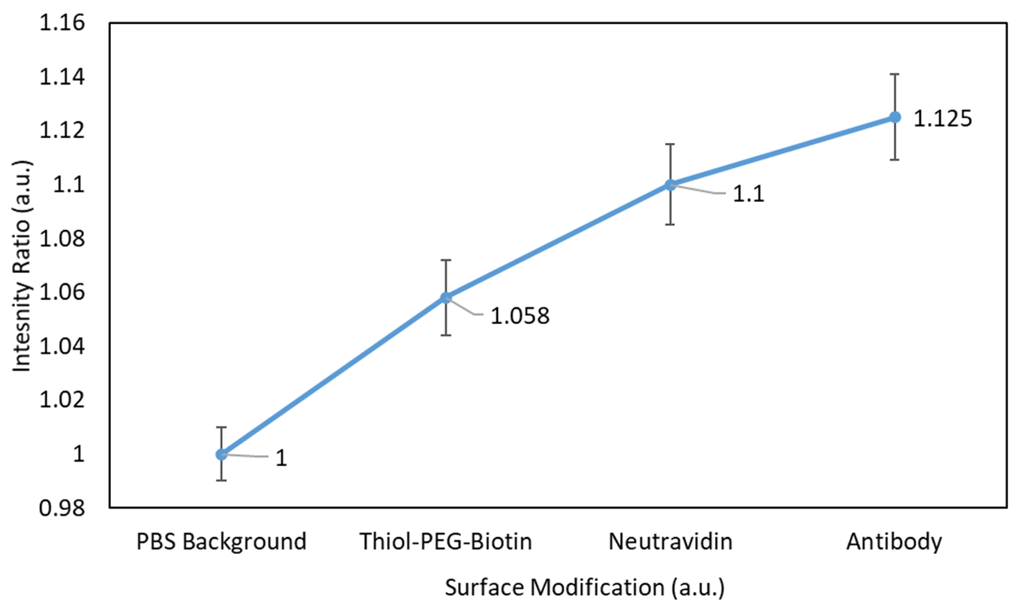
Part 2: Full surface functionalization
Anti-CD63
2 hours
Neutravidin
2hours
Bright-field Image of AGNIS immersed in PBS
Thiol-PEG Biotin (18 hours)
Scale Bar: 6 µm

Slide 6
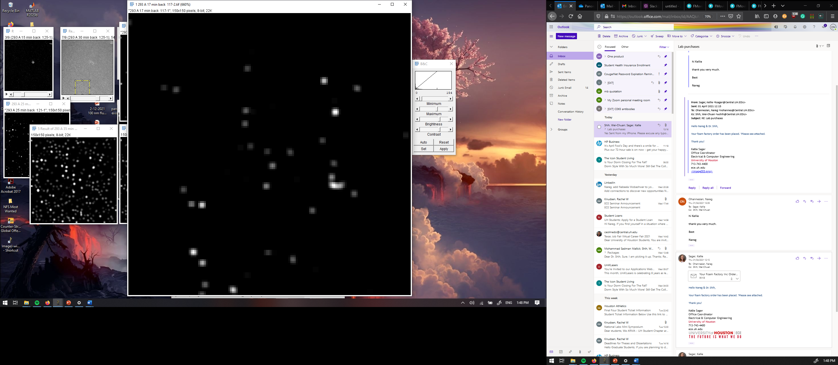
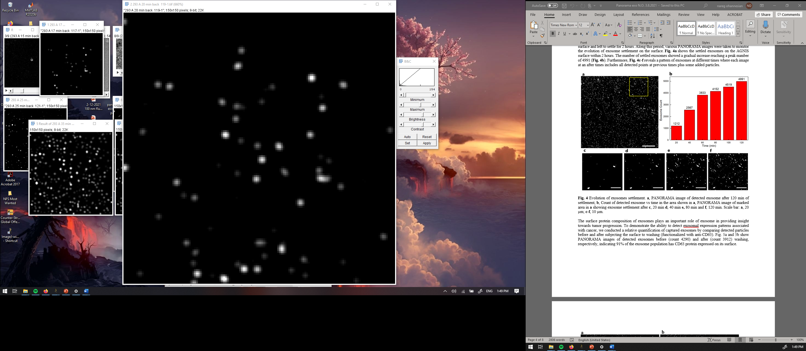


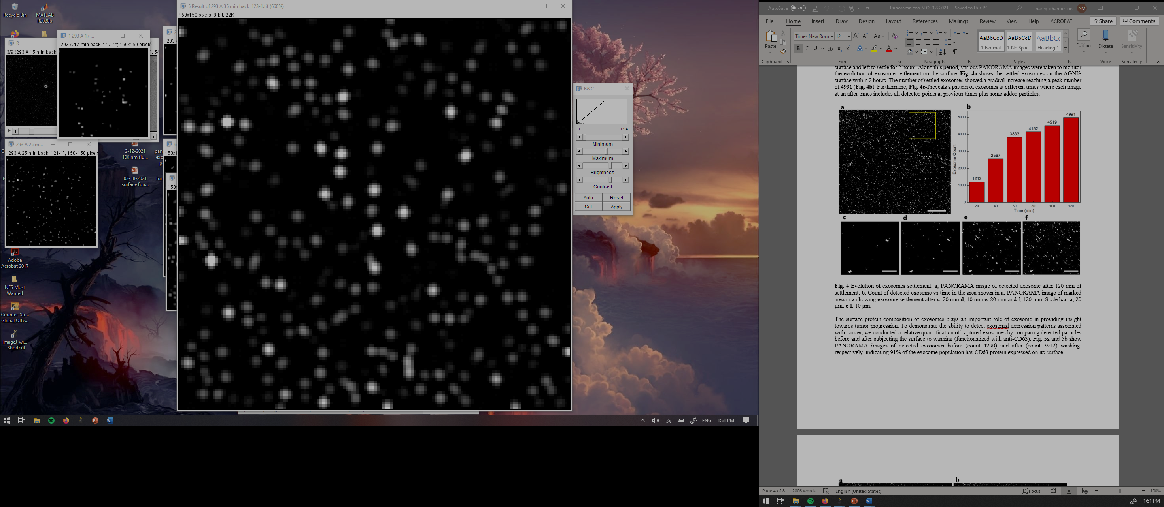
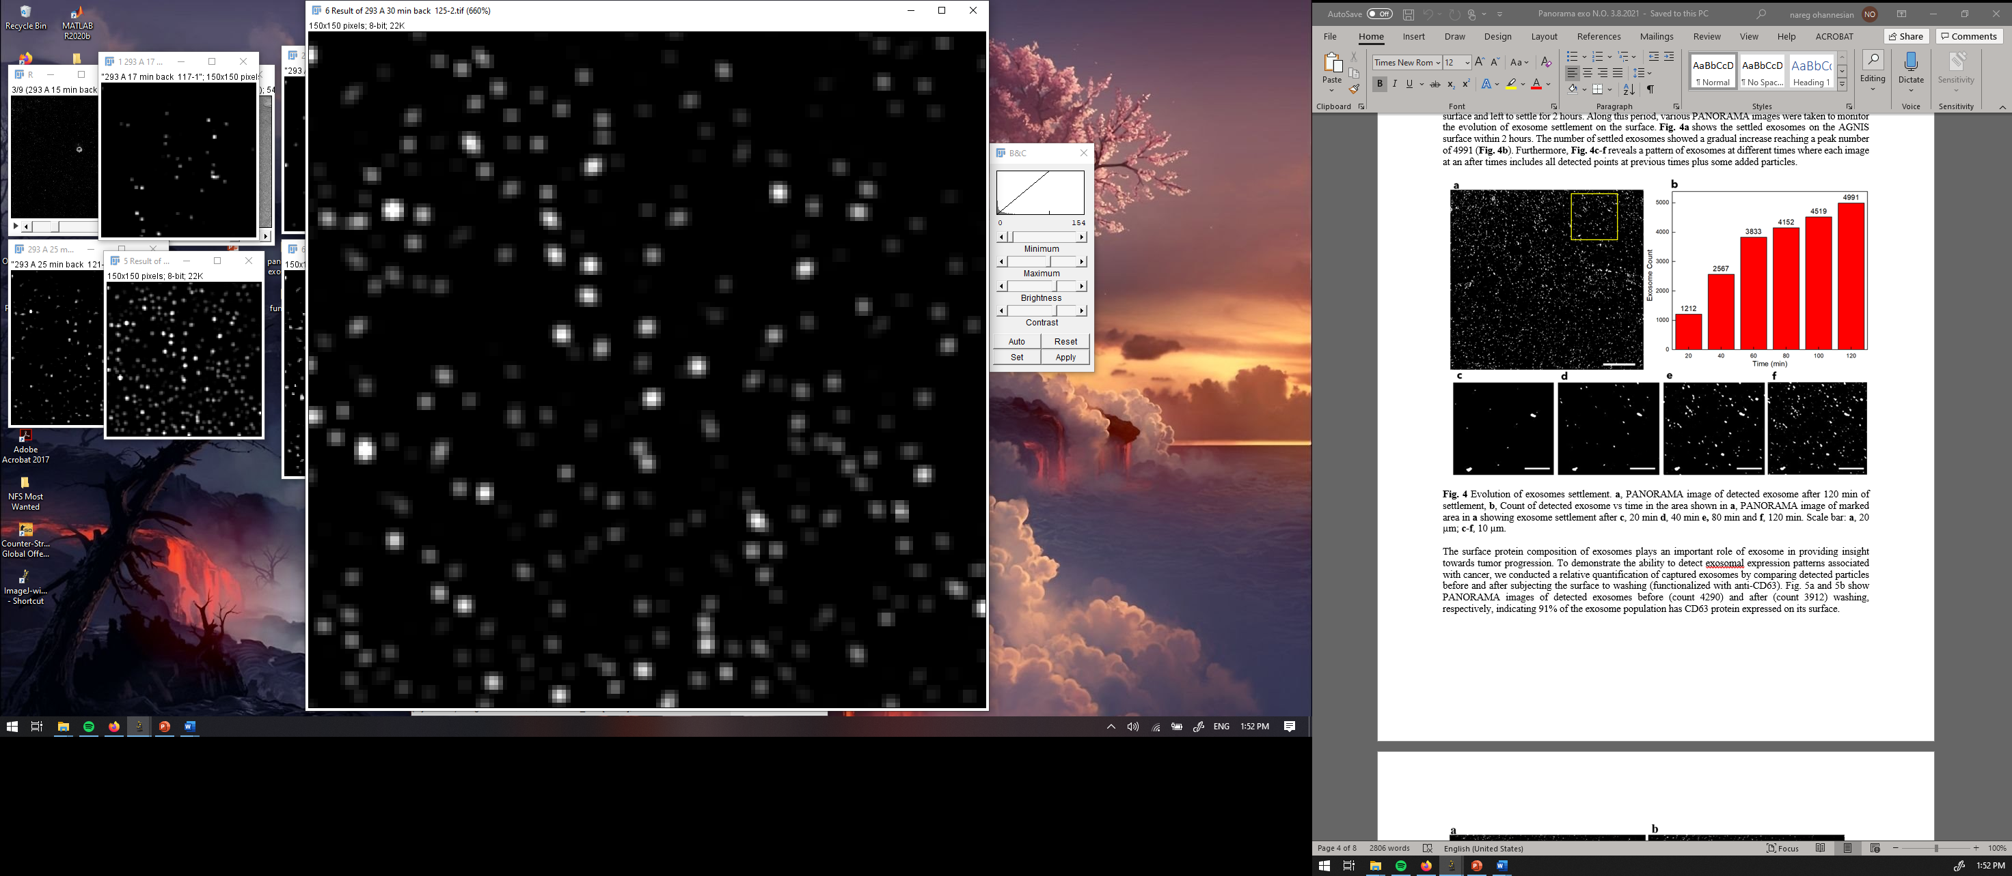
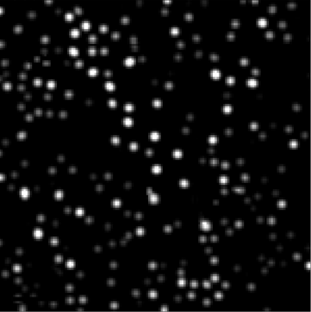
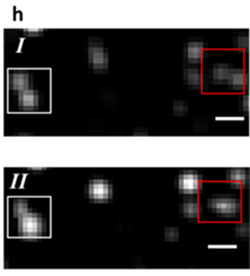
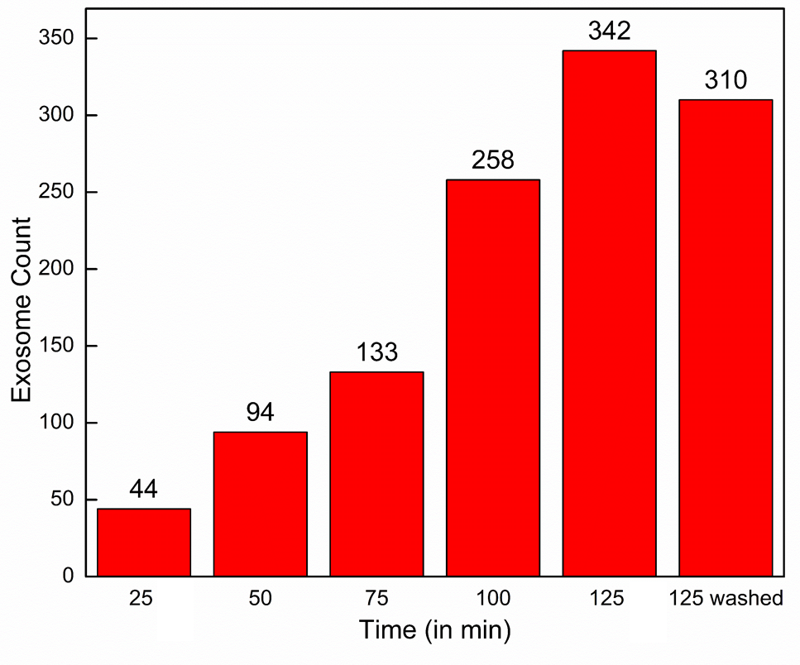

Evolution of exosome settlement with time
25 min PANORAMA
50 min PANORAMA
75 min PANORAMA
100 min PANORAMA
Exosome Concentration 2*10^5 exosomes/µl
125 min PANORAMA
125 min wash PANORAMA
125 min wash Fluorescence
Scale Bar: 4 µm

Slide 7
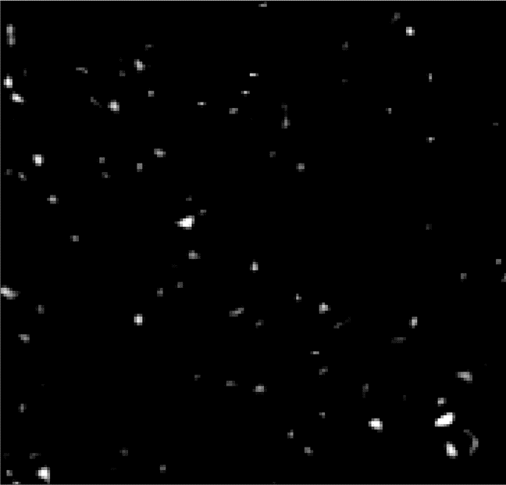
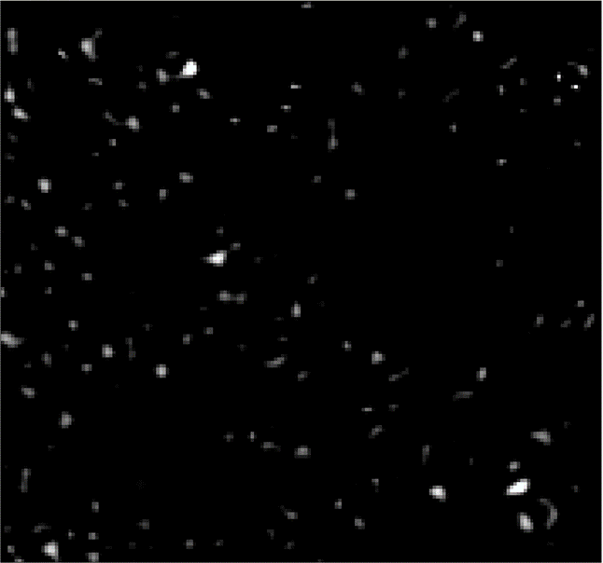
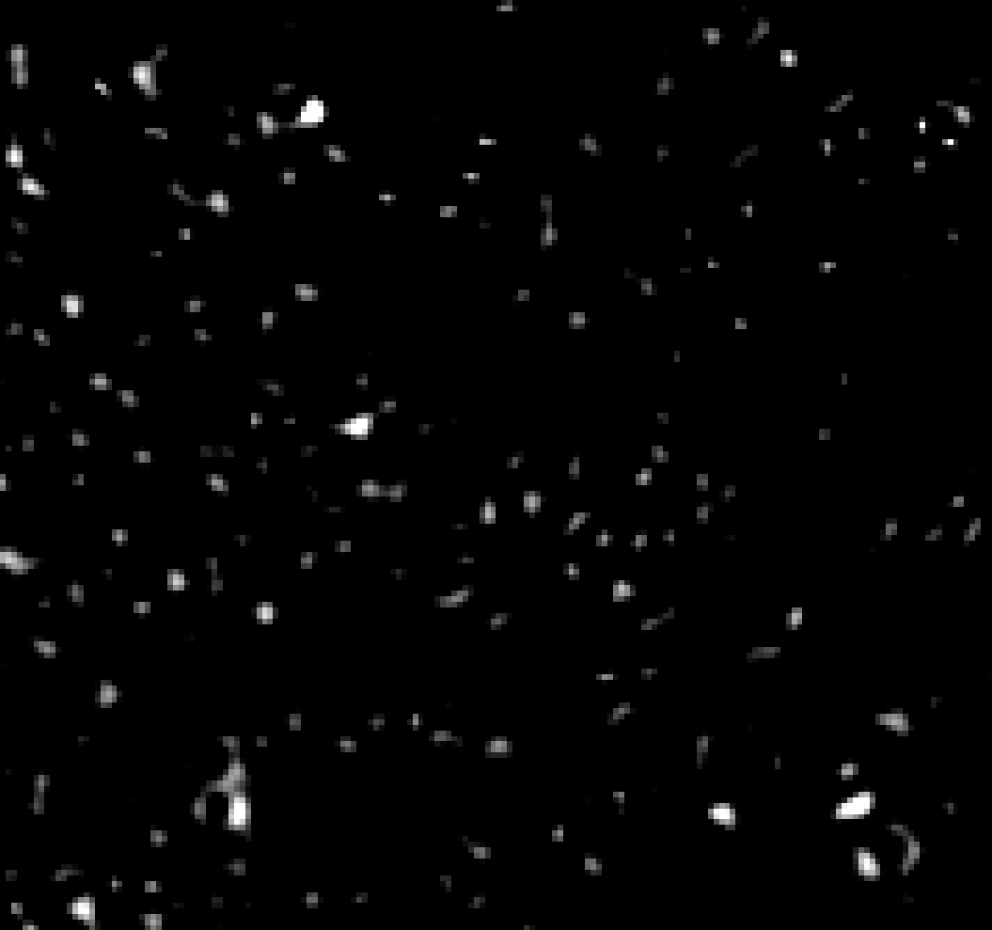
Part 3: Functionalizing AGNIS surface with Thiol-PEG-Biotin
Time: 15 min
Time: 30 min
Time: 45 min
IR: 1.045+0.026
IR: 1.053+0.022
IR: 1.053+0.023
Scale Bar: 6 µm
Notes:
Remove?

Slide 8
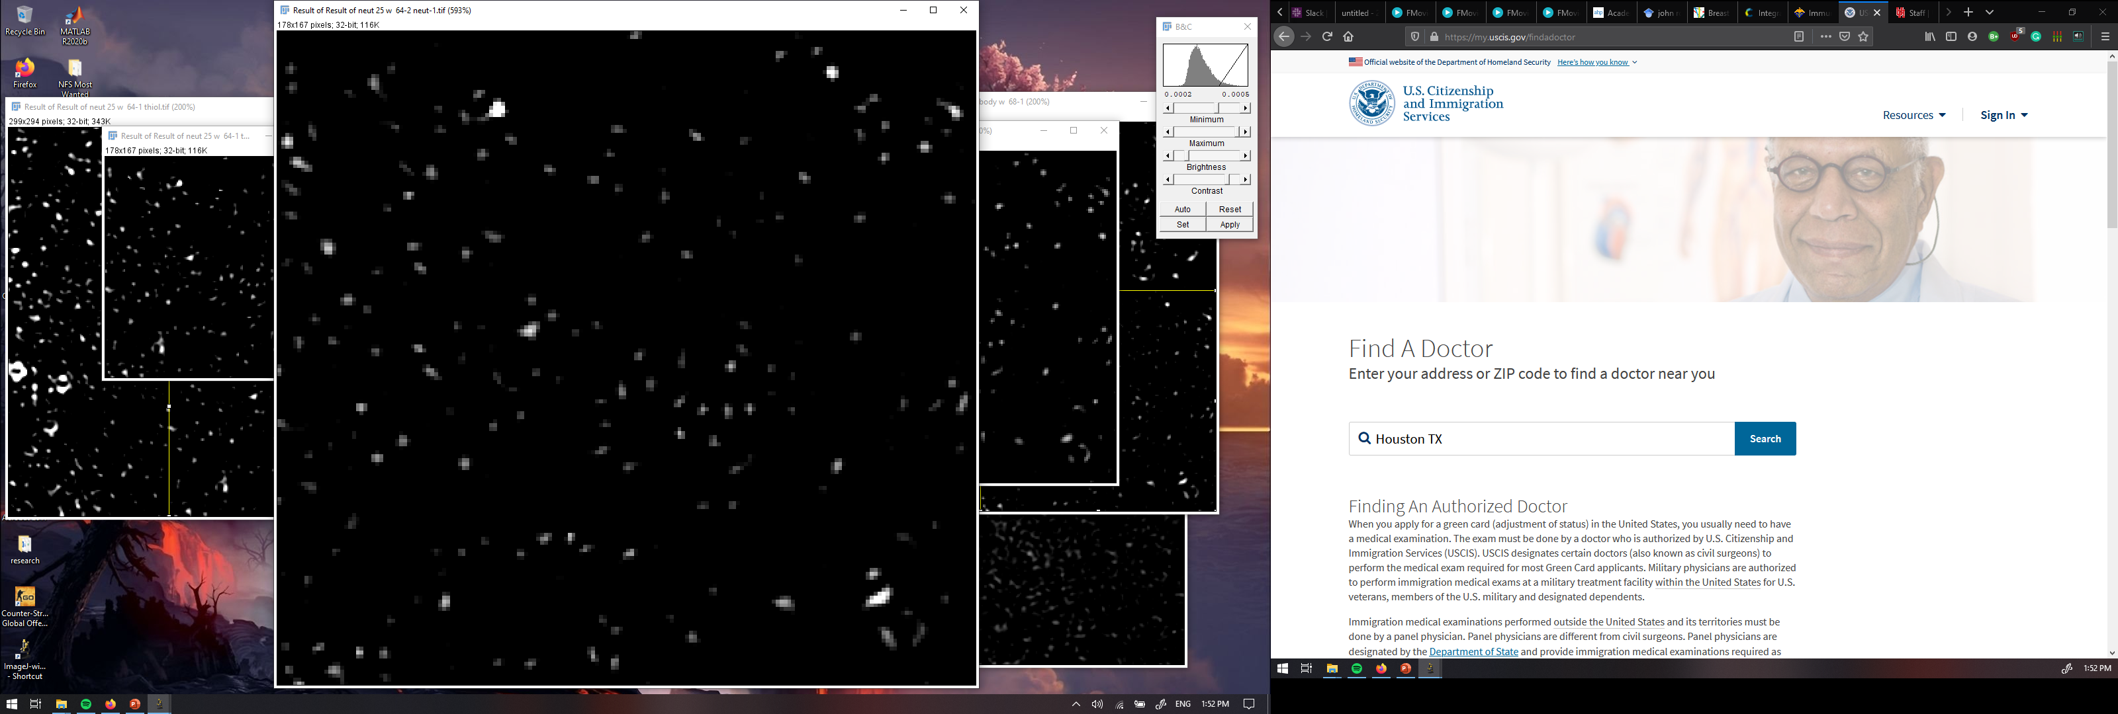

Part 1: Functionalization for 60 min to get patches after washing the surface
Thiol-Peg Biotin 1:3 Thiol-PEG MH
Neutravidin
Anti-CD63
IR: 1.053+0.028
IR: 1.095+0.021
IR: 1.113+0.018
Scale Bar: 6 µm

Slide 9
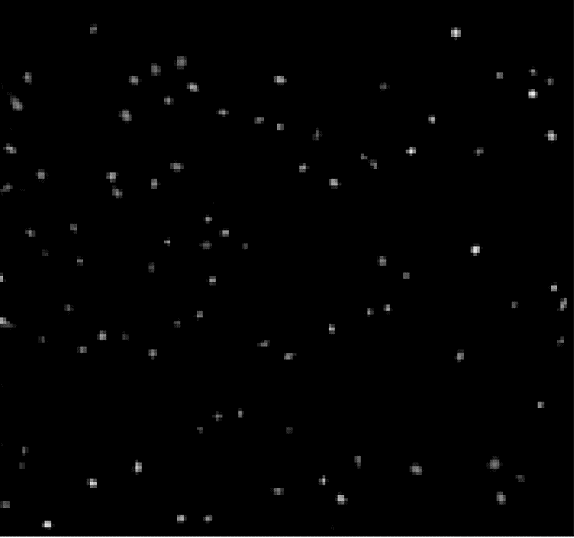
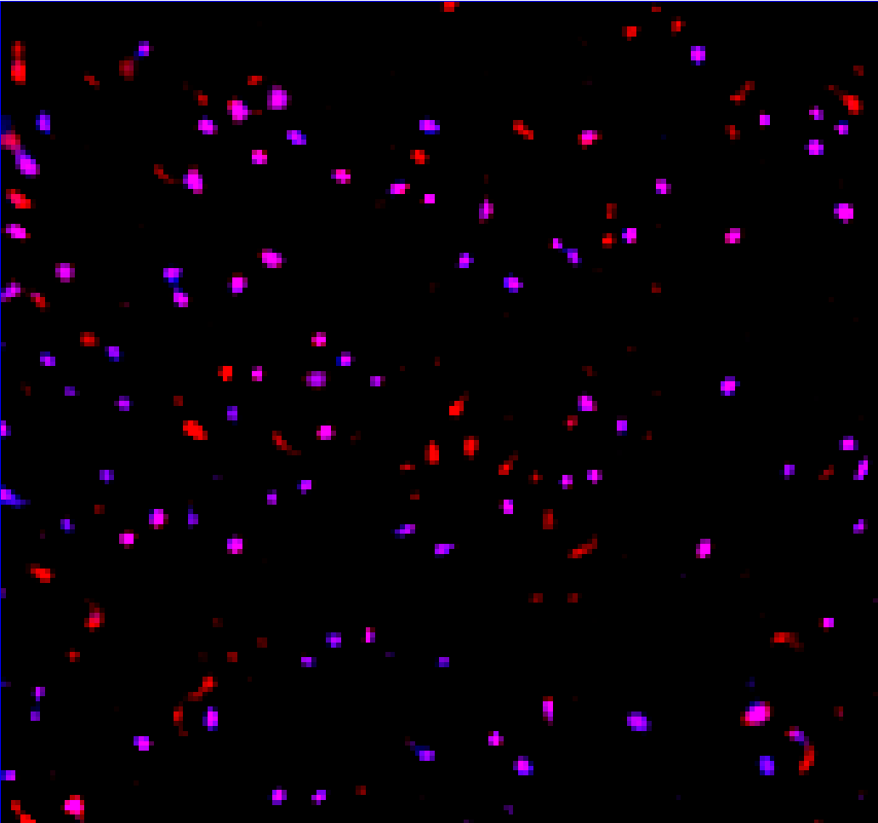
Part 1: Addition of exosomes
Functionalized spots
H460 cell line derived exosomes
Captured: 92; IR: 1.1±0.02
Overlayed images of functionalized spots and exosomes
Exosome conc. 2x10^3 ex/µl
Washed at 60 min
RED: surface functionalization
PINK: Captured Exosome
Scale Bar: 6 µm

Slide 10
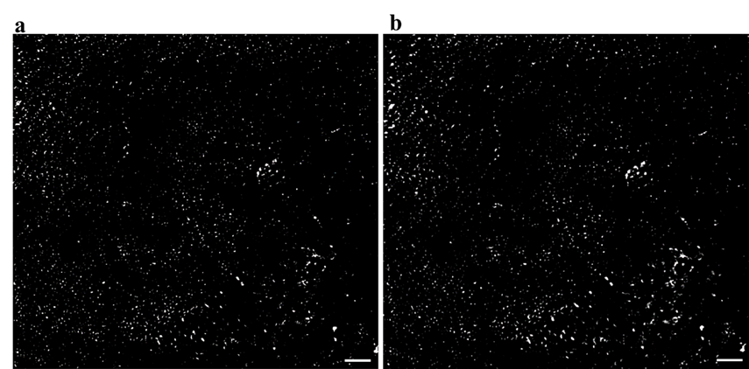
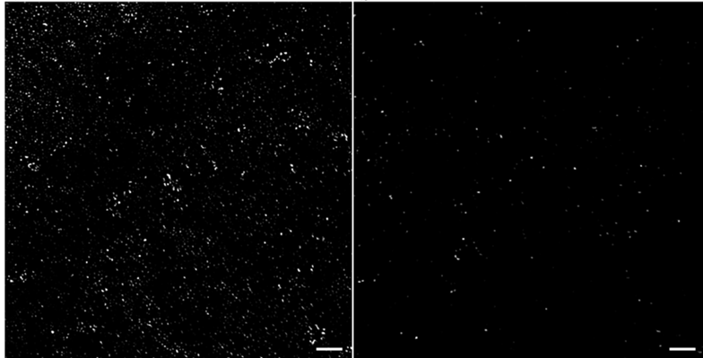
PANORAMA of H460 derived exosomes on functionalized surface with Anti-CD63 and IgG
Anti-CD63
IgG
Before wash
After wash
Before wash
After wash
91 % of exosomes odf detected exosomes were captured via anti-CD63
3.3 % remained on the surface functionalized with IgG
Scale Bar: 10 µm

Slide 11
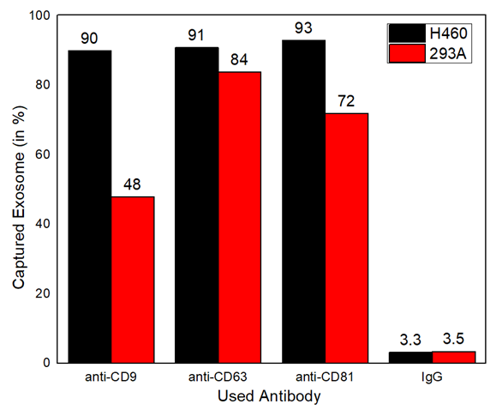
Monitoring the abundance of CD9; CD63 and CD81 surface proteins on cancerous H460 and non-cancerous 293A exosomes
Patient samples include various types of exosomes.
This graph is derived using pure exosome solutions thus cannot represent real samples
Questions on this part:
Can we use this graph to say the abundance of specific surface proteins on H460 and 293A exosomes?
This part does not have fluorescence In it. But if perform immunofluorescence capture (fluorophore labelled antibodies) does it validate our results or do we need a western blot?

Slide 12
Future work
Conclusion
PANORAMA is a label free imaging technique which can detect both 100 nm polystyrene beads and exosome particles.
Both particle detection have been validated with fluorescence.
We validate the surface functionalization by detecting them in patches at all stages of surface functionalization
Finalize the data set of the molecular beacon response for NHBE (0% response) and H460 (80%) exosomes of 25:75; 50:50 and 75:25.
Mixture of 293a and H460 and do antibody tests.
Introduce molecular beacon to plasma samples and see the variation.

